Slide 1

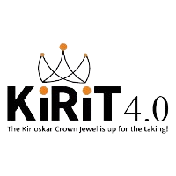
BUSINESS
KIRIT 4.0
PRESENTATION
Pushkar Kumar
Ankur Srivastava
Shreyansh Srivastava
Team Karma
NIT Raipur

Slide 2




EXECUTIVE SUMMARY
STRATEGIC EVALUATION FOR JEEVAN FOUNDRY LTD. IN THE CHANGING AUTOMOTIVE LANDSCAPE
QUESTIONS
SITUATIONS
SOLUTION
IMPACT
Should Jeevan Foundry Ltd. persist in its foundry business?
Jeevan Foundry Ltd., a major player in global metal casting, faces a strategic decision. The board resolution urges exploring alternatives due to the changing energy landscape. Mr. Sameer, Head of Operations at a major OEM making engine castings, deliberates on sticking to the current scenario or adapting to the evolving energy landscape.
STRATEGIC CONTINUITY FOR GLOBAL COMPETITIVENESS
Jeevan Foundry should maintain focus on current IC engine metal casting to sustain global competitiveness in the current market scenario.
GLOBAL RELEVANCE
Staying with current metal casting ensures Jeevan Foundry stays important globally, using its existing strengths and market position
1
If Yes, for which scenario should Mr. Sameer prepare his company?
GRADUAL SHIFT TOWARD SUSTAINABILITY
Mr. Sameer can strategically and gradually embrace renewable alternatives, aligning with future market trends and government policies for long-term sustainability.
SMART GROWTH
Gradually moving to renewable options means Jeevan Foundry grows wisely, adapting to future market trends and meeting environmental demands.
2
Should he plan for the stage-wise transition of castings from cast iron to Aluminium if
required?
3
EFFICIENT PREPARATION
Analyzing markets, ensuring quality, and smart collaborations make Jeevan Foundry well-prepared and efficient to tackle the growing market.
DATA-DRIVEN MARKET PREPARATION
Incorporate high-pressure die casting for Mr. Sameer's preparedness in the evolving aluminum industry.
Page 2

Slide 3
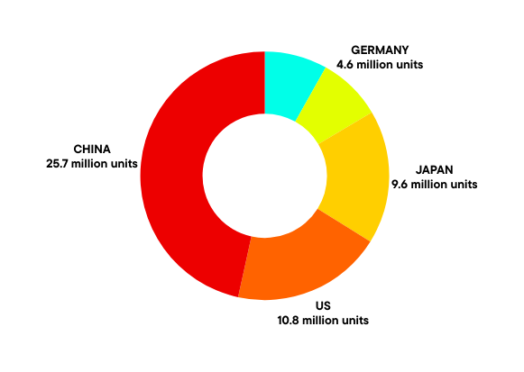
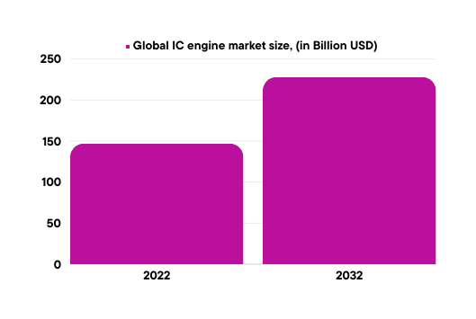
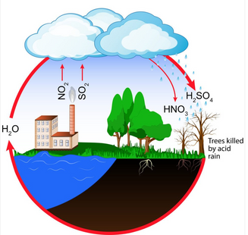
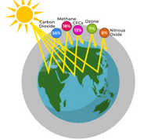



SUSTAINING EXCELLENCE
INTERNAL COMBUSTION ENGINE
Why are IC engine vehicle widely used?
Century-proven ICE technology dominates propulsion.
High-density gasoline, diesel, efficient power.
Robust infrastructure fuels, repairs, smooth travels.
Longer ranges, quicker refuels.
Versatile power: Cars, trucks, bikes thrive.
Affordable: ICE's cost edge endures.
Global Market Analysis
IC Engine Vehicle Market Leaders
Honda Motors
Volkswagen AG
Toyota Motors
Hyundai Motors
Kirloskar Oil Engines Ltd
The global internal combustion engine market size was USD 147.0 Billion in 2022 and is expected to reach USD 228.05 Billion in 2032 and register a revenue CAGR of 5% during the forecast period.
ACID RAIN
GREEN HOUSE GASES
TOP 5 AUTOMOBILE MARKETS
IMPACT OF IC ENGINE ON NATURE
The Light Duty vehicle Market was valued at USD 724.28 Bn in 2022 to reach USD 1380.83 Bn by 2030 with a forecasted CAGR of around 8.4%.
Future Goals
China has carbon neutral by 2060
US has net zero-emissions by 2050
Japan to reach net zero by 2050
Germany hits net zero emissions by 2045
India to achieve the net zero by 2070
The Heavy-Duty vehicle Market, valued at USD 204.56 billion in 2022 to reach USD 313.95 billion in 2027 with a forecasted CAGR of around 7.4% .
AIR POLLUTION
OZONE LAYER DEPLETION
NOISE POLLUTION
Page 3

Slide 4
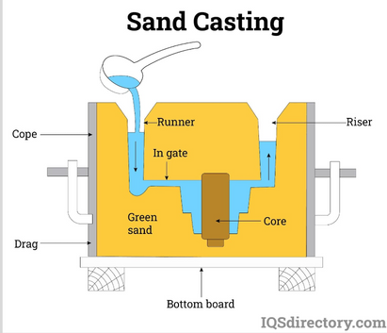
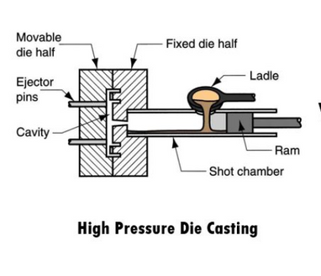
Conventional vs Alternatives
Casting Process
PARAMETERS | IC ENGINE VEHICLES | ALTERNATIVE VEHICLES
Infrastructure | Global and established | Uneven charging development
Range and Refueling Time | Longer ranges; quick refueling | Improving; charging concerns
Cost | More affordable upfront | Higher initial costs
Market Dynamics | Dominant, especially where alternatives lag | Gaining traction, especially in urban areas
Light-Duty Vehicles | Common; alternatives growing | Increasing preference for alternatives
Heavy-Duty Vehicles | Critical for heavy industries; slow alternative adoption | Transition challenging; alternatives gaining attention
Sand casting is a metal casting process using sand molds. Molten metal is poured into the mold, forming the desired shape."
High-Pressure Die Casting (HPDC) is a metal casting process using high pressure to inject molten metal into intricate molds.
What are the major components of IC engine formed by casting?
1. Engine Block 2. Cylinder Head
3. Crankcase 4. Pistons
5. Connecting Rods 6. Camshaft
7. Intake and Exhaust Manifolds 8. Engine Mounts and Brackets
Vehicle weight, size, and fuel consumption
Vehicle weight, size, and fuel consumption are all intimately connected. A vehicle with a significantly lower weight will consume significantly less energy per kilometer traveled.
MATERIAL | WEIGHT SAVINGS | WEIGHT REDUCTION POTENTIAL
Conventional steel & iron | 0% | 1.0
Aluminium | 45% | 1.8
IC engines persist due to infrastructure, versatility, innovation, and cost benefits. Light Duty vehicle endure till 2040, heavy-duty vehicles(transportation) remain relevant until 2060.
Aluminum engine blocks weighs half as much as iron blocks .
Page 4

Slide 5
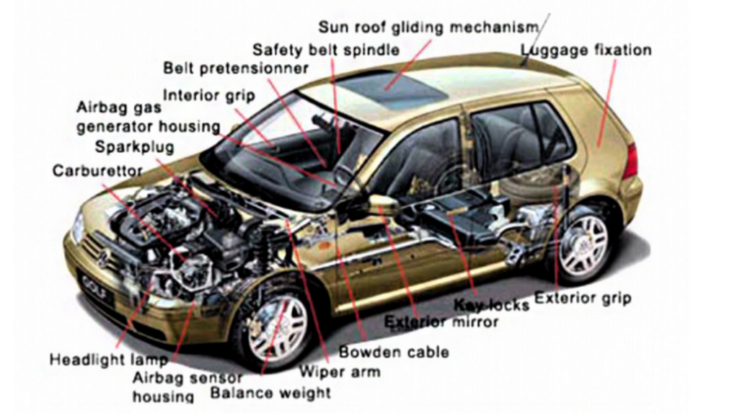
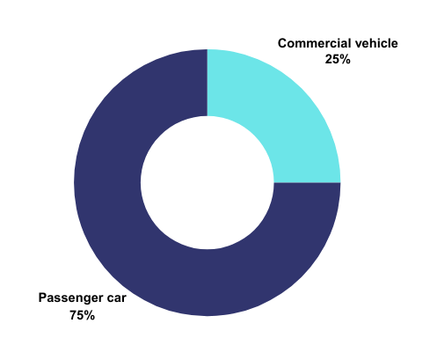


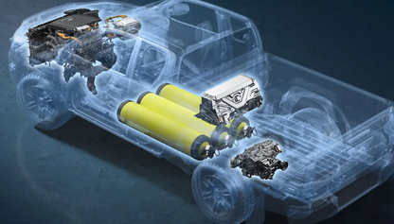
High-Pressure Die Casting (HPDC) VS Sand Casting
Other automotive parts formed by HPDC
FEATURE | SAND CASTING | HPDC
Surface finish & tolerance | Generally lower; may require post-machining | Superior finish; tighter tolerances
Production rate | Slower | Higher; suitable for mass production
Material compatibility | Wide range of metals & alloys | Primarily non-ferrous metals (aluminum &magnesium)
Tooling cost | Relatively lower | Higher initial cost, justified for mass production
Complexity of parts | Suitable for large and complex castings | Ideal for intricate and geometrically complex parts
ALTERNATIVE FUEL VEHICLES
HPDC is favored for its efficiency, precision, and suitability for mass production especially in the manufacturing of lightweight components like aluminum engine blocks.
HYDROGEN COMBUSTION
VEHICLE
ELECTRIC VEHICLE
MODIFIED CNG VEHICLE
With rising sales of the passenger car segment demand for HPDC is witnessing promising growth. Nowadays, passenger car demand. HPDC in their different car components owing to their lightweight features and higher tensile strength.
Automotive Aluminum HPDC Market- Revenue Share (%) by vehicle type ,2021
Page 5

Slide 6
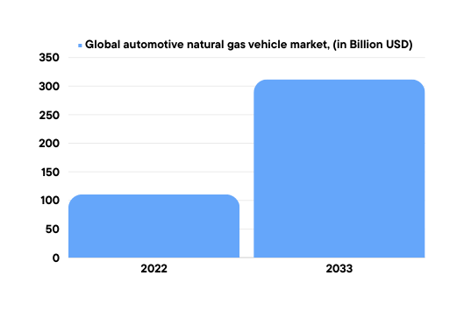
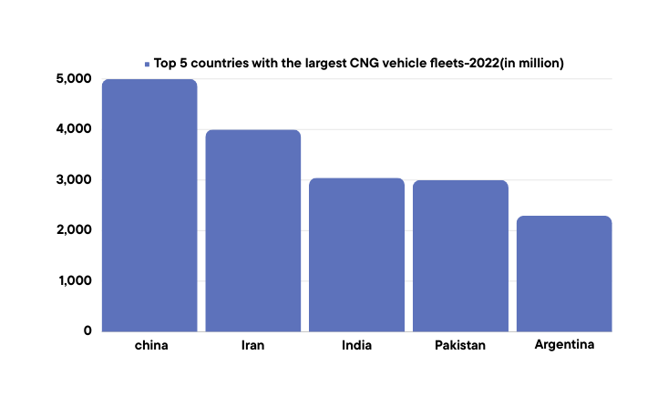
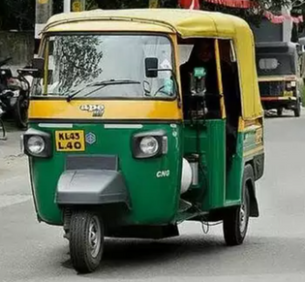
Navigating the CNG Landscape
GLOBAL MARKET ANALYSIS
JEEVAN FOUNDRY'S STRATEGIC MOVES TOWARDS MODIFIED CNG ENGINES TECHNOLOGY
The global Automotive Natural Gas Vehicle Market is expected to reach USD 312 Billion by 2032, at a CAGR of 10.9% during the forecast period 2022 to 2032.
Diversification of Casting Processes
R&D for CN
CAGR in 2022-33
10.9%
Integrate High-Pressure Die Casting (HPDC) for lightweight and efficient CNG engine components
Develop CNG-tailored alloys for enhanced durability, thermal conductivity, and corrosion resistance
China have the highest number of CNG run vehicles in the world. Natural gas vehicles are increasingly used in Iran, Pakistan, the Asia-Pacific region, the Indian capital of Delhi, and other large cities such as, Mumbai, Pune, and Kolkata.
Training and Skill Development
CNG VEHICLE COMPONENTS
Establish training programs for workforce skill enhancement in HPDC technology
Fuel Injection System
CNG Storage Tank Components
Engine blocks, cylinder heads, and pistons but , their design and materials differs from conventional IC engines
CNG Vehicle Market Leaders
General Motors
Volkswagen AG
Honda Motor Company
Toyota Motor Corporation
Ford Motor Company
The fuel is mostly used by taxi drivers because of its much lower price compared to petrol.
Page 6

Slide 7
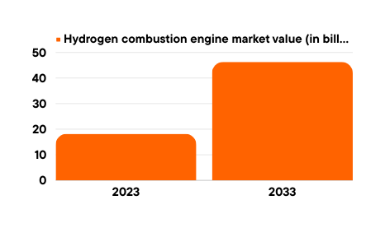
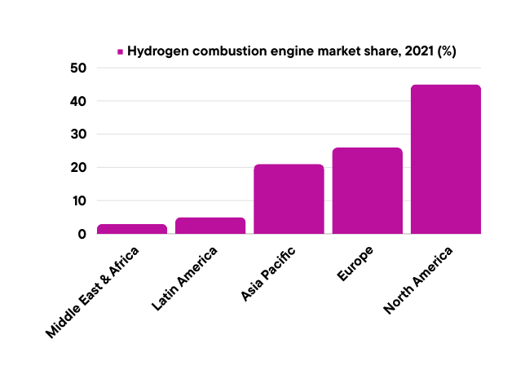
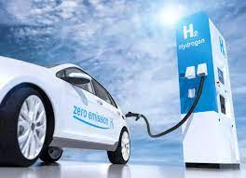
Hydrogen-Driven Revolution
GLOBAL MARKET ANALYSIS
JEEVAN FOUNDRY'S STRATEGIC MOVES TOWARDS HYDROGEN COMBUSTION TECHNOLOGY
The market value of hydrogen combustion engines in 2023 was USD 18.22 billion, with a value of USD 46.31 billion by 2033, with CAGR in 2033 is 9.78%.
Research and Development
Specialized Casting Services
CAGR in 2023-33
9.78%
Invest in R&D to develop advanced casting techniques(HPDC) and materials suitable for hydrogen combustion engine components
Offer specialized casting services for hydrogen engine components, including cylinder heads, engine blocks, pistons, and fuel injection systems.
North America being the largest market of hydrogen combustion engines in the world.
Training and Certification
Provide training and certification programs for employees to enhance their skills in casting techniques and hydrogen engine technology.
Hydrogen internal combustion engine (ICE) Vehicle Market Leaders
Toyota
Yochai
AVL
Cummins
Mazda
Page 7

Slide 8
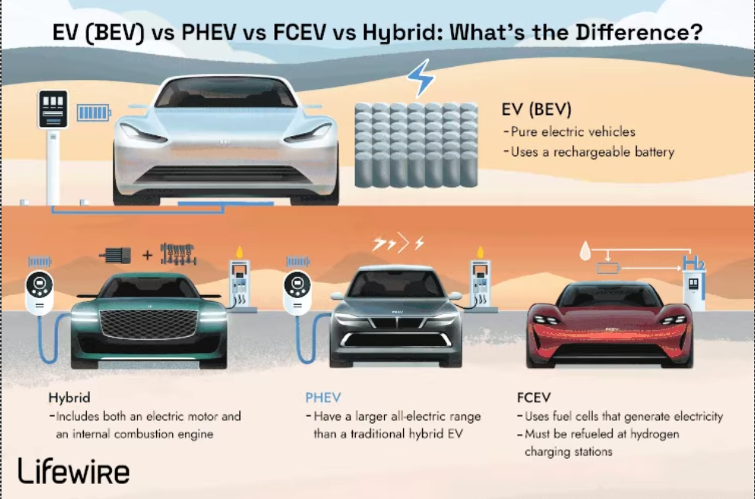
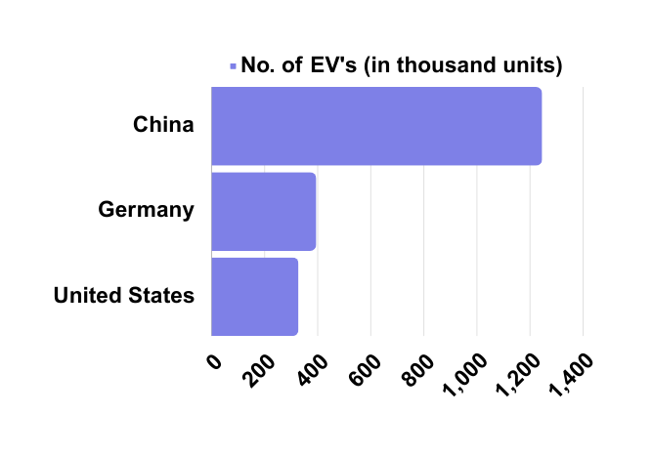
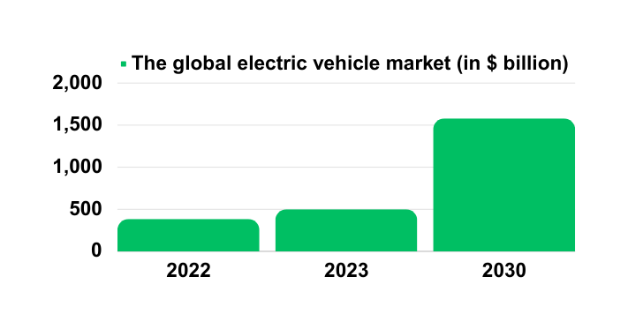
Electrifying the Road Ahead
ELECTRIC VEHICLE
Fuel Cell Electric Vehicle (FCEV)
Battery Electric Vehicle
(BEV)
Plug-in Hybrid Electric Vehicle (PHEV)
Hybrid Electric Vehicle
(HEV)
Global market analysis
Who Leads the Charge Towards Electric Mobility
The global electric vehicle market size is estimated at USD 384.65 billion in 2022 and is projected to grow from USD 500.48 billion in 2023 to USD 1,579.10 billion by 2030, exhibiting a CAGR of 17.8% during the forecast period of 2023-2030.
China tops global plug-in car numbers, owning 20.41 million units as of December 2023, almost half of the global fleet.
By 2026, over 50% of China's new passenger vehicle sales are projected to be electric.
EV Market Leaders
BYD
Tesla
Volkswagen
Nissan
BMW
Page 8

Slide 9
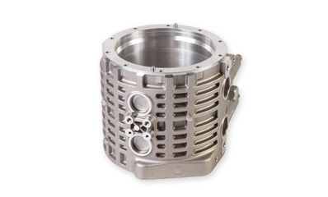
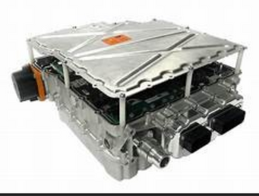
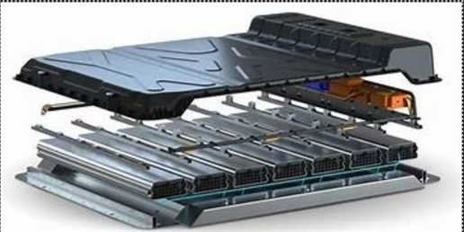
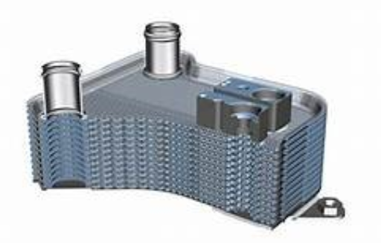
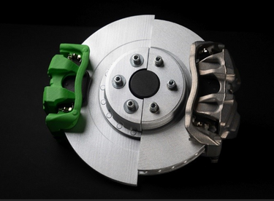
BEV (Battery Electric Vehicle) Market
Career Alternatives for Mr. Sameer in the EV Sector
The global ratio between BEVs and PHEVs was to 71:29 in 2021.Battery Electric Vehicle (BEV) Market size surpassed USD 300 billion in 2022 and is anticipated to grow at 15% CAGR from 2023 to 2032, driven by the tightening regulatory scenario around fossil-fuel powered vehicle emissions globally.
HOUSINGS FOR BATTERIES, MOTORS & INVERTER
1
Why Are BEV’S Preferred?
CRITERIA | BEV | PHEV | HEV | FCEV
Cost | Higher | Moderate | Lower | Higher
Range | High | Limited | Moderate | Comparable
Market | Growing rapidly | Increasing steadily | Widely available | Limited
Common use | Daily use | Daily use | General use | Limited commercial use
Charging infrastructure | Expanding charging | Requires both electric | No plug-in capability | Limited hydrogen infrastructure
EV HOUSING
EQUIPMENTS
2
HEAT EXCHANGERS AND COOLING FINS TO ENSURE EFFICIENT THERMAL MANAGEMENT WITHIN EV SYSTEMS.
3
Jeevan Foundry, a global casting industry giant, can pave its way into the EV sector through strategic use of High-Pressure Die Casting (HPDC), leveraging its expertise for a sustainable future.
4
REGENERATIVE BRAKING & SUSPENSION SYSTEMS
Page 9

Slide 10
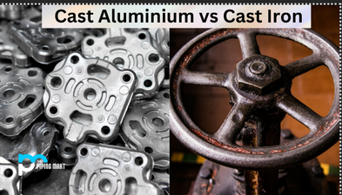
STRATEGIC TRANSITION TOWARDS ALUMINUM
Stage 1: Exploration and Preparation
Stage 2: Crafting Innovative Solutions
Aluminum vs Cast Iron: Unveiling Preference
Stage 3: Testing the Waters
MARKET CHECK
Explore the demand for aluminum in renewable energy
Identify the specific aluminum components required.
CAPABILITY ASSESSMENT
Evaluate our current aluminum casting abilities.
Plan necessary upgrades for efficiency.
PROTOTYPES
Craft test versions of aluminum components.
Enhance based on valuable feedback.
COLLABORATION
Team up with renewable energy manufacturers.
Design customized aluminum components.
START SMALL
Begin with small-scale aluminum production.
Learn and enhance based on user input.
QUALITY ASSURANCE
Implement strict quality checks.
Obtain essential certifications for reliability.
PROPERTY | CAST ALUMINUM | CAST IRON
Weight | Lightweight | Heavyweight
Strength | High | Exceptional
Corrosion Resistance | Excellent | Moderate
Thermal Conductivity | High | High
Stage 6: Leading the Industry
Stage 5: Going Full Throttle
Stage 4: Expanding Our Reach
INNOVATION DRIVE
Invest in research and development for efficiency.
Strive to be a frontrunner in aluminum casting.
STRATEGIC ALLIANCES
Forge key partnerships for collective progress.
Play a role in advancing the entire industry.
SCALING UP
Gradually increase aluminum production.
Invest wisely to meet growing demand.
CONTINUOUS REFINEMENT
Focus on improving our processes.
Stay at the forefront of technological advancements.
DIVERSIFICATION
Expand our range of aluminum components.
Explore opportunities in new sectors.
BRAND BUILDING
Highlight the environmental benefits of our products.
Establish a trustworthy brand identity.
In line with the Paris Agreement's sustainability goals, Mr. Sameer should prefer aluminum over cast iron. Aluminum's lightweight, high-temperature resistance, and corrosion resistance align with eco-friendly initiatives, making it ideal for renewable alternatives, promoting energy efficiency and reducing environmental impact in industrial applications.
Page 10

Slide 11
CONCLUSION
1. SMART GLOBAL MARKET RETENTION
Jeevan Foundry Ltd. is wise to stick with the global IC engine market for now.
The shift to renewable alternatives in the automotive sector is happening gradually, allowing the company to capitalize on existing opportunities without rushing into major changes.
2. KEY EMPHASIS ON HIGH-PRESSURE ALUMINUM DIE CASTING
Specializing in high-pressure aluminum die casting is key.
This aligns perfectly with the emerging trends in EVs and hybrids, meeting the expectations outlined in the Paris Agreement and positioning the company for future success.
3. STRATEGIC ADOPTION, NOT ABRUPT CHANGE
Mr. Sameer's leadership in a strategic and gradual adoption of new technologies is crucial.
Continuing with the current business while embracing changes gradually allows Jeevan Foundry to remain a strong player in the global metal casting industry.
4. STEP-BY-STEP TRANSITION INFORMED BY ANALYSIS
A step-by-step transition, guided by comprehensive market analysis, is the way forward.
Understanding market trends and aligning transition stages with the company's strengths will ensure a smooth evolution.
5. COMPETITIVE EDGE THROUGH INFORMED DECISIONS
In-depth market analysis at each stage is critical for maintaining a competitive edge.
This approach ensures that decisions are well-informed, enabling Jeevan Foundry to adapt effectively to the changing dynamics of the industry.
6. ALIGNING WITH GOVERNMENT RECOMMENDATIONS
Actively aligning with government initiatives is a wise move.
Staying in sync with changing regulations and market trends positions the company as a responsible and compliant player in the industry.
7. SUSTAINABLE MARKET ADAPTATION
Adapt to demand for EVs, hybrids, and CNG casting. Ensure sustainability, regulatory compliance, and position as a responsible industry player.
Embrace eco-friendly options for sustainability and compliance, and position Jeevan Foundry as a responsible industry player, eligible for government incentives.
In conclusion, the combination of strategic retention, gradual adoption, and a commitment to informed decision-making will enable Jeevan Foundry Ltd. to navigate the evolving landscape of the global metal casting industry with confidence and resilience.
Page 11

Slide 12
REFERENCES
https://www.fortunebusinessinsights.com/industry-reports/electric-vehicle-market-101678
https://tse1.mm.bing.net/th?id=OIP.5Q7jWWmzcGFmfdpDi-bJ7wHaFj&pid=Api&P=0&h=180
https://tse4.mm.bing.net/th?id=OIP.5hYbjobvOPwpxLsmJIeeBQHaFW&pid=Api&P=0&h=180
https://tse3.mm.bing.net/th?id=OIP.OH3ZaQH2iNelF6LQBBLr3QHaDt&pid=Api&P=0&h=180
https://www.iea.org/reports/global-ev-outlook-2021/trends-and-developments-in-electric-vehicle-markets
https://tse2.mm.bing.net/th?id=OIP.tpMcrCVpndoviz3IT3fungHaDt&pid=Api&P=0&h=180
https://www.futuremarketinsights.com/reports/hydrogen-combustion-engine-market
https://tse2.mm.bing.net/th?id=OIP.4U4SGL8txiGfV4VpV-cENAHaE8&pid=Api&P=0&h=180
https://www.precedenceresearch.com/hydrogen-combustion-engine-market
https://e-amrit.niti.gov.in/types-of-electric-vehicles
https://www.reportsanddata.com/report-detail/compressed-natural-gas-cng--vehicles-market
Page 12

